Slide 1
FACE MASK DETECTION
Gowtham, Dhanush, Hubert Ryan, Mullai Balaji
Department Of Computer Engineering, Kingston Engineering College
Department Of Computer Engineering, Kingston Engineering College
Department Of Computer Engineering, Kingston Engineering College
Department Of Computer Engineering, Kingston Engineering College
-----------------------------------------------------------------------------------------------------------
Abstract:-- Corona Virus (coronavirus) According to the World Health Organization, the COVID-19 pandemic is creating an international health crisis, and the most successful safety method is wearing a mask in public places. The COVID-19 pandemic compelled governments all over the world to implement lockdowns in order to prevent virus transmission. According to reports, wearing a face mask while at work significantly decreases the risk of transmission. A cost-effective and cost-effective method of using AI to create a safe environment in a manufacturing setting. For mask detection, a hybrid model using techniques such as deep and classical machine learning is provided. A face mask detection dataset consists of images with and without masks. We're going to try to time period face detection from a live stream from our webcam using OpenCV. Using Python, OpenCV, Tensor Flow, and Keras, we will create a COVID-19 face mask detector with computer vision. Our aim is to use computer vision and deep learning to determine whether or not the person in the image/video stream is wearing a mask.
Keywords – Face Mask Detection, Machine Learning, Deep Learning, Keras, Tensorflow, COVID -19, Video, Dataset, Model, Computer Vision
∴∴∴
I. INTRODUCTION
Because of the global COVID-19 corona virus outbreak, the wearing of face masks in public is becoming more common. People used to wear masks to protect their health from air pollution before Covid-19. Others, who are self-conscious about their appearance, mask their feelings from the public eye by covering their ears. COVID-19 transmission is clogged by wearing face masks, according to scientists. COVID-19 (also known as the corona virus) is the most recent epidemic virus to strike human health in the last century. COVID-19 has been declared a global pandemic by the World Health Organization (WHO) in 2020 due to its rapid spread.
COVID-19 infected over 5 million people in 188 countries in less than 6 months. The virus spreads by close contact and huddled, overcrowded environments.
The corona virus outbreak has resulted in unprecedented levels of international scientific collaboration. Machine learning and Deep Learning, which are assisted by artificial intelligence (AI), can aid in the battle against Covid-19 in a variety of ways. Researchers and clinicians may use machine learning to predict the distribution of COVID-19 and use it as an early warning system for possible outbreaks. pandemics, as well as to identify and classify vulnerable groups. Aid distribution requires funding for emerging technologies such as artificial intelligence, IoT, big data, and machine learning in order to combat and forecast new diseases, better understand infection patterns, and trace and easily detect infections. AI's capacity is being used to combat the Covid-19 pandemic. In some countries, people are required by law to wear face masks in public. These rules and laws were created in response to the exponential increase in cases and deaths in a variety of areas. The method of tracking large groups of people, on the other hand, is becoming more complicated. Anyone who isn't

Slide 2
|| Volume 6 || Issue 5 || May 2021 ||
ISO 3297:2007 Certified
ISSN (Online) 2456-3293
wearing a face mask is detected during the observation process.
We're going to implement a mask face recognition model that uses deep learning and computer vision. The proposed model could be used in conjunction with police work cameras to prevent COVID-19 transmission by detecting individuals who are not wearing face masks. The model was created using opencv, tensor flow, and keras, as well as deep learning and traditional machine learning techniques. For feature extraction, we combined deep transfer learning with three traditional machine learning algorithms. We made a comparison between them to find out which one is the best. within the method of coaching and detection, the required algorithmic rule that achieved the highest accuracy and consumed the smallest amount of time.
PROBLEM STATEMENT
Some people are unaccustomed to wearing masks in this modern age, where we are more likely to contract a virulent disease and other people all around us are advised to do so. The project's main point is that if we can use AI to find people wearing or not wearing masks in public places, we'll be able to increase our protection. If used correctly, the mask detector will almost certainly be used to help ensure our protection.
Also, it's terribly depressing to be alive during this period, to witness much of what's going on in the world, so I figured why not make anything of it, i.e. turn a real-world problem, in which we have a propensity to wear masks when we go outside, into a Machine Learning problem.
Our research focuses on stance detection, which may be a totally different form of detecting false news. Stance detection is a technique for mechanically investigating the connection between two pieces of text. In this study, we look at how to predict someone's stance using a news article and a news headline.
MOTIVATION
As COVID-19 cases resurface throughout the world, it's critical to stay committed to helping to stop the virus from spreading. Although you can always wash your hands, cover your coughs and sneezes, avoid rubbing your ears, and adhere to social distancing laws, wearing a mask is an additional precaution you should take. Here’s why:
COVID-19 spreads more commonly through person-to- person communication, as we've learned during the pandemic. When an infected person coughs, sneezes, or speaks, metastasis droplets are released, which can fly up to six feet and land in the mouths or noses of others nearby. COVID-19 can also be spread by people who don't realise they have the virus because they don't have any symptoms.
As a result, the center for Disease Control and Prevention recommend wearing masks or artefact face coverings to help slow the virus' spread.
The COVID-19 pandemic has changed the way we live. Many people are staying at home, avoiding people on the road, and modifying everyday activities, such as going to college or work, in ways we never expected. While we are changing recent behaviours, we want to follow new patterns. First and foremost, we have a habit of wearing a mask or face covering while we are in a very public place. Following previous outbreaks of infectious diseases, we've learned that simple, reliable messaging about what people can do to protect themselves and their communities are important.
PROJECT OBJECTIVES
To shield ourselves from the COVID-19 Pandemic, virtually everyone puts on a face mask. In most public events, such as malls, theatres, and parks, it is becoming increasingly important to see if people in the crowd wear face masks. The development of an AI solution to detect whether a character is wearing a face mask and grant them access could be extremely beneficial to society. In this project, a simple Face Mask detection machine is built using Convolutional Neural Networks, a Deep Learning method (CNN). This CNN Model is built with the TensorFlow system and the OpenCV library, which are both excellent used for real-time applications. This version can also be used to extend a full-fledged software application so that anyone can test it out before submitting it to the general public. This version achieves a level of accuracy of over 96 percent. This can also be used in conjunction with other methods to improve accuracy levels even more.
II LITERATURE REVIEW
In many use cases, such a device is unquestionably needed under the current Covid-19 lockdown period. The following are a few examples of applications that may benefit from this scheme.
Airports: While not goggles, the proposed System could be of great value to sight travellers at airports. The information of travellers may be recorded as videos in the system at the entrance. If a passenger is discovered without a face mask, an alarm is sounded, alerting the airfield authorities to take immediate action.
Hospitals: The proposed system could be combined with CCTV cameras, and the information could be used to see if any of their employees are wearing masks. If a doctor is discovered without a mask, they will be sent a note to put one on.
Offices: The proposed framework would aid in the maintenance of safety standards in order to prevent the spread

Slide 3
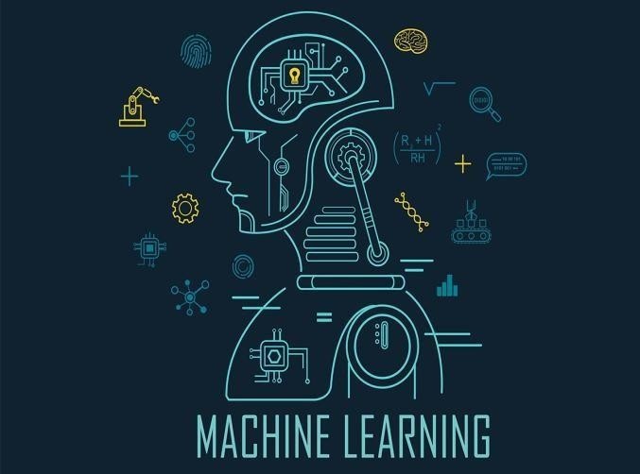
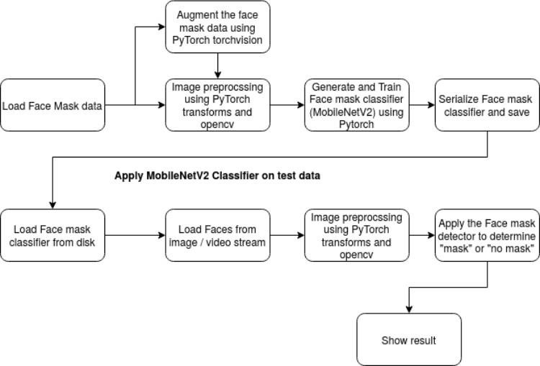
|| Volume 6 || Issue 5 || May 2021 ||
ISO 3297:2007 Certified ISSN (Online) 2456-3293
of Covid-19 or any other airborne disease. If a worker is not wearing a mask, they will be reminded to do so.
III IMPLEMENTED SYSTEM
The proposed framework uses the OpenCV, Tensor flow, Keras, and PyTorch libraries to identify a person wearing a face mask in an image/video stream using computer vision and deep learning algorithms.
Approach
Develop a deep learning model (MobileNetV2)
Application of the model mask detector model to images or a live video stream
Flow Chart
Data at Source
1) OpenCV was used to enhance the majority of the images. “Mask” and “no mask” were already written on the set of images. The images were of various sizes and resolutions, and were most likely taken from a variety of sources or from computers (cameras) with varying resolutions.
ALGORITHM USED MACHINE LEARNING
Machine learning is the study of computer algorithms that improve over time as a result of their use. It's thought to be a set of artificial intelligence. Machine learning algorithms build a mathematical model based on sample data, known as training data, to make new predictions or make other decisions although they are not explicitly programmed to do so.
Fig -1: Machine learning outlook
Depending on the essence of the "signal" and "feedback" available to the learning system, machine learning methods are historically divided into three different categories:
Supervised learning: The computer is given examples of inputs and the need for required outputs, with the aim of learning a standard rule that maps inputs to outputs.
Unsupervised learning: The training algorithm isn't given a name, so it's left to figure out structure in an input on its own. Unattended learning may be a target in and of itself (finding hidden patterns in data) or a means to an end (finding hidden patterns in data) (feature learning).
Reinforcement learning: A computer programme interacts with a complex world in which it must achieve a specific objective (such as driving a car or playing a game against an opponent). As it navigates its problem space, it receives feedback in the form of rewards, which it attempts to optimise.
Other procedures have emerged that do not fit the neatness of this three-fold categorization, and the same machine learning method usually uses more than one.
COMPUTER VISION
Computer vision is a knowledge-based science area that deals with how machines can interpret visual images or videos at a
2) 1) Data preprocessing
Any or all of the raw input pictures were subjected to the data preprocessing steps outlined below in order to turn them into clean versions that could be fed to a neural network machine learning model.
Resize the picture that has been given (256 x 256)
RGB colour filtering is applied to the channels (Our model MobileNetV2 supports 2nd three channel image)
Scaling / Normalizing images using PyTorch's built-in weights and the quality mean.
Cropping the picture in the centre with a 224x224x3 element price
Finally, they'll be converted to tensors (Similar to NumPy array)

Slide 4
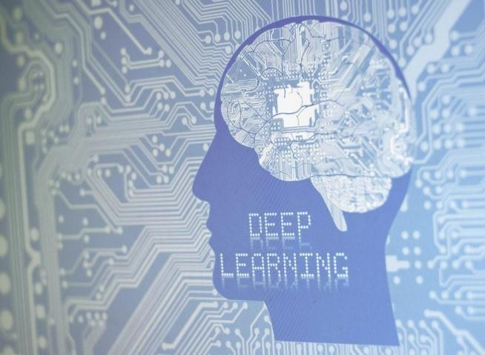
|| Volume 6 || Issue 5 || May 2021 ||
ISO 3297:2007 Certified
ISSN (Online) 2456-3293
high level. Computer vision tasks include techniques for collecting, processing, analysing, and interpreting digital images, as well as the extraction of high-dimensional data from the real world in order to provide numerical or symbolic knowledge, such as in the form of decisions. In this sense In this context, understanding refers to the conversion of visual images (retinal input) into representations of the world that are relevant to thought processes and may elicit appropriate action. The disentangling of symbolic knowledge from image data using models built with the assistance of geometry, physics, and learning theory is what this image can help us understand.
The idea behind artificial systems that extract information from images is the subject of computer vision. Video loops, multiple camera views, and multi-dimensional knowledge from a 3D scanner or medical scanning system can all be examples of image knowledge. Computer vision is a scientific discipline that aims to apply its theories and models to the development of laptop vision systems. Computer vision is an interdisciplinary area that studies how machines can be programmed to interpret visual images or videos at a high level. It aims to change the tasks that the human visual system can perform from an engineering standpoint.
Cloud Computing
The distribution of different resources over the Internet is known as cloud computing. These resources include information storage, databases, networking, servers, and software, among other tools and applications.
Instead of saving files to a proprietary drive or local storage unit, cloud-based storage allows them to be saved to a remote database. As long as an electronic device has internet connectivity, it has access to information as well as the software programmes needed to operate it.
For a variety of reasons, including cost savings, increased productivity, speed and efficiency, performance, and security, cloud computing can be a popular option for individuals and businesses.
Since the information being accessed is located remotely inside the cloud or a virtual space, cloud computing is classified as such. Cloud service providers allow users to store files and software on remote servers and then access them through the Internet. This means the user doesn't have to be in the same position to gain access to it, allowing them to work remotely.
Cloud computing moves all of the work of crunching and processing data away from the laptop you're carrying or sitting at. It also transfers all of the work to massive computer clusters that are isolated in cyberspace. Your information,
jobs, and applications are accessible from any computer that can connect to the Internet, anywhere in the world.
Cloud computing is a term that encompasses both public and private cloud computing.
Public cloud providers charge for their services provided over the Internet. Private cloud providers, on the other hand, only provide services to a certain group of people. These services are comprised of a network of networks that provide hosted services.
There is also a hybrid alternative, which combines elements of both public and private services.
DEEP LEARNING
Deep learning aim of these approaches is to learn function features from higher levels and then apply to the lower level options. Without relying entirely on human features, a device can learn complex functions mapping the incoming input to the output directly from data by mechanically learning features at multiple levels of abstraction. Deep learning algorithms get to take advantage of the unknown structure within the input distribution in order to discover good representations, usually at multiple levels, with higher-level learn features outlined in terms of lower-level choices.
Fig – 2: Deep learning
The hierarchy of concepts allows the machine to deduce more complex concepts by constructing them from simpler ones. If we draw a graph showing how these definitions are constructed on top of each other, we'll see that the graph is very complex, with many layers. As a result, we've moved to AI deep learning. Deep learning performs well in domains of analogue inputs (and also outputs). They are images of pixel data, documents of text data, or files of audio data, rather than a collection of quantities in a highly tabular format. Deep learning allows computational models made up of multiple process layers to discover information representations at multiple level of abstraction.
04

Slide 5
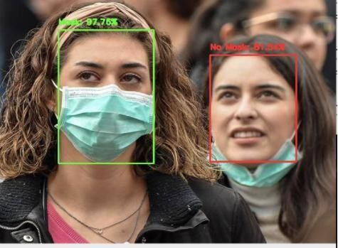
|| Volume 6 || Issue 5 || May 2021 ||
ISO 3297:2007 Certified
ISSN (Online) 2456-3293
OpenCV
OpenCV (Open Source Computer Vision Library) is a free software library for computer vision and machine learning. OpenCV was created to provide a standard infrastructure for laptop vision applications, as well as to speed up the adoption of machine perception in commercial products. Businesses will find it easy to use and change the code thanks to OpenCV.
The library has more than 2500 optimised algorithms, which includes a comprehensive set of each classic and state-of- the-art laptop vision and machine learning algorithms These algorithms may be used to detect and acknowledge faces, identify objects, classify human actions in videos, track camera movements, moving objects, extract 3D models of objects, turn out 3D purpose clouds from stereo cameras, stitch images together to produce a high resolution image of an entire scene, find similar images from an image database, take away red eyes from pictures taken mistreatment flash, follow eye movements, acknowledge scenery and establish markers to overlay it with increased reality, and so forth OpenCV has over forty seven thousand folks of user community and calculable number of downloads exceeding
18 million. The library is used extensively in companies, analysis teams and by governmental bodies.Along with well- established companies like Google, Yahoo, Microsoft, Intel,
IBM, Sony, Honda, Toyota that employ the library, there are several startups akin to Applied Minds, Video Surf, and Zeitera, that make extensive use of OpenCV. OpenCV’s deployed uses span the range from stitching street view images together, detecting intrusions in surveillance video in Israel, observance mine instrumentation in China, helping robots navigate and pick up objects at Willow Garage, detection of swimming bath drowning accidents in Europe, running interactive art in European nation and New York, checking runways for debris in Turkey, inspecting labels on product in factories round the world on to speedy face detection in Japan.
It supports Windows, Android, and Mac OS and has C++, Java, and Python interfaces. OpenCV is primarily used for time-based vision applications, and it makes use of MMX and point directions when they are accessible. There are over 500 algorithms and about ten times as many functions that make up or endorse such algorithms. OpenCV is written in C++ and has a model interface that integrates with STL containers seamlessly.
TENSORFLOW
TensorFlow is a free and open-source software library for dataflow and differentiable programming that can be used to solve a wide range of problems. It's a symbolic mathematics library that's also used in machine learning applications
including neural networks. TensorFlow is Google's second- generation system, and version 1.0.0 was released on February 11th. Unlike the reference implementation, which runs on single computers, TensorFlow can run on multiple CPUs and GPUs.
Tensor Flow is available for 64-bit Linux, macOS, Windows, and Android and iOS mobile computing platforms. Its adaptable architecture allows for easy computation preparation on a variety of platforms (CPUs, TPUs, GPUs).
KERAS
Keras is a human-centric API, not a machine-centric one. Keras adheres to industry best practises for reducing psychological feature load by providing consistent and quick APIs, reducing the number of user actions needed for common use cases, and providing transparent and unfair error messages. It also comes with a lot of documentation and
developer guides. Keras includes a variety of implementations of commonly used neural-network building blocks including layers, goals, activation functions, optimizers, and a slew of other methods to make working with image and text data and writing deep neural network code simpler. The code is hosted on GitHub, and community support forums include a Slack channel and a GitHub problems tab. Keras may be a lightweight Python deep learning library that runs on top of Theano or Tensor Flow. It was created with the goal of making the implementation of deep learning models as simple and fast as possible for research and development. It runs on Python 2.7 or 3.7 and, depending on the underpinning frameworks, can run on both GPUs and CPUs. It's available under the Massachusetts Institute of Technology's permissive licence.
François Chollet, a Google engineer, created Keras with four guiding principles in mind:
Modularity: A model may be viewed as a single sequence or graph. A deep learning model's issues are all discrete components that can be combined in a variety of ways.
Minimalism: The library is designed to be easy enough to achieve a goal, with no unnecessary frills, while still increasing readability.
Extensibility: Researchers can easily add new sections to the structure and use them, allowing them to test and explore new ideas. There are no different files with custom
05

Slide 6
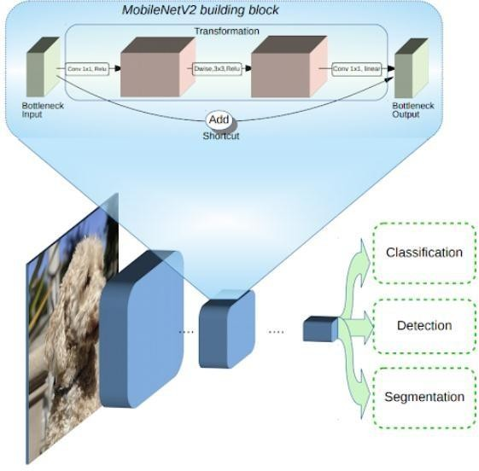
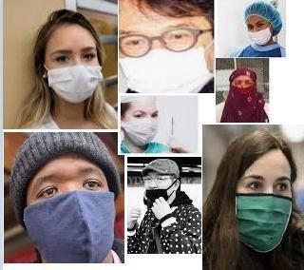
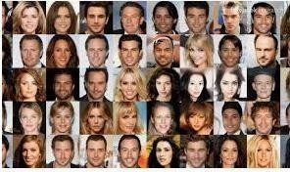
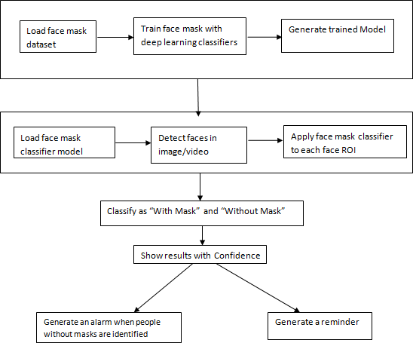
|| Volume 6 || Issue 5 || May 2021 ||
ISO 3297:2007 Certified ISSN (Online) 2456-3293
file formats in Python. All is indigenous. Python Keras is designed for simplicity and modularity, enabling you to easily identify and run deep learning models on top of a Theano or TensorFlow backend.
Scan the images/video stream for faces.
Use the classifier on each face ROI.
Confidently classify the images as ‘With Mask' or ‘Without Mask.'
IV SYSTEM DESIGN
This system aims at classifying whether a person is wearing a mask or not by taking input from
--Images
--Real time streaming Videos
The proposed system considers dataset of size 1300 images [14].
The model is coached in two phases to complete the classification of the photographs:
The face mask dataset is loaded into the device in phase one.
Different Supervised Learning classifiers are used to build a coaching model.
Fig 3: Architecture of Proposed Face mask detection system This system might then be interfaced with
Case 1: Existing access scheme that restricts violators.
Case 2: There can be occasions at work when people forget or simply discard the mask because it is difficult for them to become acquainted with the new face masks. In such situations, the system's warning causes disruption among other employees. As a result, concerned authorities should take appropriate steps to warn the individual so that they can resume wearing their mask.
The typical MobilenetV2 architecture has several layers, which are described below. Instead of defining/building our own model in Pytorch, we can use the models library in Torch Vision to construct the MobileNetV2 model. The ImageNet dataset is used to determine the weight of each layer in the model. The padding, kernel size, input channels, and output channels are all represented by weights. MobileNetV2 has selected an algorithm to use in order to create a model that can be used on a mobile device. On top of the MobileNetV2 model, a customised completely connected layer with four sequential layers was created. The layers are
Average Pooling layer with 7×7 weights
Linear layer with ReLu activation function
Dropout Layer
2nd Phase:
Open the mask classifier model and load it.

Slide 7
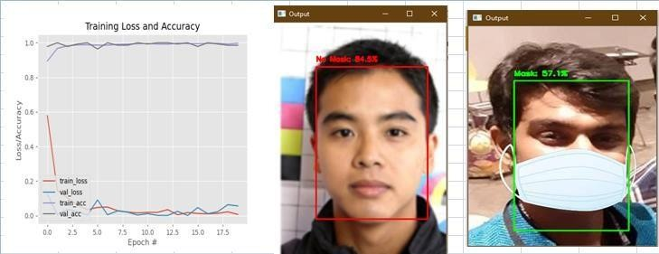
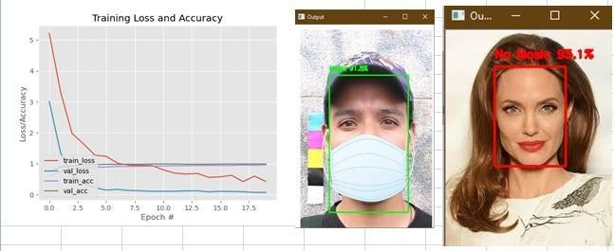
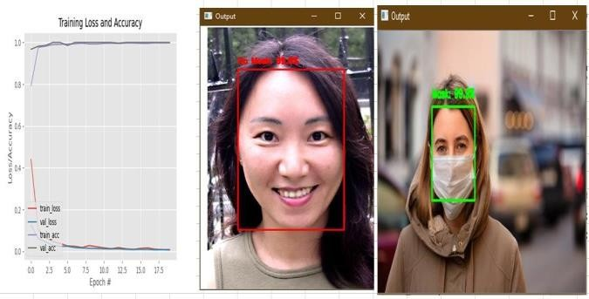
|| Volume 6 || Issue 5 || May 2021 ||
ISO 3297:2007 Certified
ISSN (Online) 2456-3293
4. Linear layer with Softmax activation function with the result of 2 values
The softmax function in the final layer returns two probabilities, one for each classification of "mask" or "not mask."
V RESULT.
The experimental results of the system performance are evaluated with the following classifiers and optimizers.
Table 1: Results of the proposed system with MobilenetV2 classifier:
Fig5: Training Loss and Accuracy Plot and Results of Resnet50 Classifier with ADAM Optimizer
Table 3: Results of the proposed system with VGG16 classifier.
Classifier | Epochs | Train/te st size | Optimizer | Train loss | Train Accuracy | Test Loss | Test accuracy
Mobilenet V2 | 20 | 90/10 | ADAM | 0.0090 | 0.9981 | 0.0071 | 1.0000
 |  |  | ADAGRAD | 0.2454 | 0.9148 | 0.1811 | 0.9819
 |  |  | SGD | 0.1549 | 0.9502 | 0.0216 | 0.9855
Classifier | Epochs | Train/te st size | Optimizer | Train loss | Train Accuracy | Test Loss | Test accuracy
VGG16 | 20 | 90/10 | ADAM | 0.2145 | 0.9826 | 0.0006 | 1.0000
 |  |  | ADAGRAD | 1.7911 | 0.8425 | 0.4243 | 0.9638
 |  |  | SGD | 0.5133 | 0.9536 | 0.1055 | 0.9928
From the Table 1 it is observed that performance of ADAM optimizer is good in both training and testing when compared with other two optimizers ADAGRAD and SGD
Fig6: Training Loss and Accuracy Plot and Results of VGG16 Classifier with ADAM Optimizer
As compared to the other two optimizers ADAGRAD and SGD, the efficiency of the ADAM optimizer is good in both training and testing, as seen in Table 3, but SGD test accuracy is roughly equal to ADAM.
VI CONCLUSION
The output of the ADAM optimizer is very high, and the test accuracy of SGD is roughly equal to ADAM for all three classifiers considered above, according to the results of the different classifiers.
Fig4: Accuracy Plot of an training loss and Results of MobilenetV2 with ADAM Optimizer
Table 2: Results of an proposesed system with Resnet50 classifier:
Classifier | Epochs | Train/test size | Optimizer | Train loss | Train Accuracy | Test Loss | Test accuracy
Resnet50 | 20 | 90/10 | ADAM | 0.0068 | 0.9975 | 0.0557 | 0.9856
 |  |  | ADAGRAD | 0.1087 | 0.9693 | 0.0019 | 1.0000
 |  |  | SGD | 0.1114 | 0.9693 | 0.0100 | 1.0000
During the trial, it was discovered that the MobileNetV2 classifier produces the best results with the highest accuracy.
REFERENCES
[1] P. A. Rota, M. S. Oberste, S. S. Monroe, W. A. Nix, R. Campagnoli, J. P. Icenogle, S. Penaranda, B. Bankamp,K. Maher, M.-h. Chenet al., “Characterization of a novel coronavirus associated with severe acute respiratorysyndrome,”science, vol. 300, no. 5624, pp. 1394– 1399, 2003.
Table 2 shows that the ADAM ADAM optimizer performs well in training and testing as compared to the other two optimizers, ADAGRAD and SGD, and all test accuracies appear to be high.
[2] Z. A. Memish, A. I. Zumla, R. F. Al-Hakeem, A. A. Al- Rabeeah, and G. M. Stephens, “Family cluster of middleeast

Slide 8
|| Volume 6 || Issue 5 || May 2021 ||
ISO 3297:2007 Certified
ISSN (Online) 2456-3293
respiratory syndrome coronavirus infections,”New England Journal of Medicine, vol. 368, no. 26, pp.2487–2494, 2013.
Y. Liu, A. A. Gayle, A. Wilder-Smith, and J. Rocklöv, “The reproductive number of covid-19 is higher comparedto sars coronavirus,”Journal of travel medicine, 2020.
Y. Fang, Y. Nie, and M. Penny, “Transmission dynamics of the covid-19 outbreak and effectiveness of governmentinterventions: A data-driven analysis,”Journal of medical virology, vol. 92, no. 6, pp. 645–659, 2020.
N. H. Leung, D. K. Chu, E. Y. Shiu, K.-H. Chan, J. J. McDevitt, B. J. Hau, H.-L. Yen, Y. Li, D. KM, J. Ipet al.,“Respiratory virus shedding in exhaled breath and efficacy of face masks.”
S. Feng, C. Shen, N. Xia, W. Song, M. Fan, and B. J. Cowling, “Rational use of face masks in the covid- 19pandemic,”The Lancet Respiratory Medicine, 2020.
Z. Wang, G. Wang, B. Huang, Z. Xiong, Q. Hong, H. Wu,
P. Yi, K. Jiang, N. Wang, Y. Peiet al., “Masked facerecognition dataset and application,”arXiv preprint
arXiv:2003.09093, 2020.[10]Z.-Q. Zhao, P. Zheng, S.-t. Xu,
and X. Wu, “Object detection with deep learning: A review,”IEEE transactions on neural networks and learning systems, vol. 30, no. 11, pp. 3212–3232, 2019.
[8] A. Kumar, A. Kaur, and M. Kumar, “Face detection techniques: a review,”Artificial Intelligence Review, vol. 52,no. 2, pp. 927–948, 2019.D.-H. Lee, K.-L. Chen, K.-H. Liou, C.-L. Liu, and J.-L. Liu, “Deep learning and control algorithms of direct perception for autonomous driving,2019

